Slide 1
Setup
Go to https://code.preferred.ai/recommendation-retrieval
Set up the environment
Python3 https://www.python.org/downloads/release/python-360/
Jupyter notebook https://jupyter.org/install
Clone repository
Install packages
Start Jupyter notebook
$ git clone https://github.com/PreferredAI/recommendation-retrieval.git
$ cd recommendation-retrieval
$ pip3 install -r requirements.txt
$ jupyter notebook

Slide 2

Recent Advances in Scalable Retrieval of Personalized Recommendations
A Tutorial
Dung D. Le
Singapore Management University
ddle.2015@smu.edu.sg
Hady W. Lauw
Singapore Management University
hadywlauw@smu.edu.sg
Slides available at
https://code.preferred.ai/recommendation-retrieval
Notes:
Cover Slide with Image

Slide 3
Outline
MF Recommendation Retrieval as Similarity Search Problem
Two phases of a MF Recommender System
Linear Scanning is not Scalable for Real-time Applications
Hands-on Session
Approaches for Scalable Recommendation Retrieval
Approximate Maximum Inner Product Search
Hands-on Session
Indexable Representations
Hands-on Session
Discrete Representations

Slide 4
Part I:
MF Recommendation Retrieval as Similarity Search Problem

Slide 5

CHOICES

Slide 6
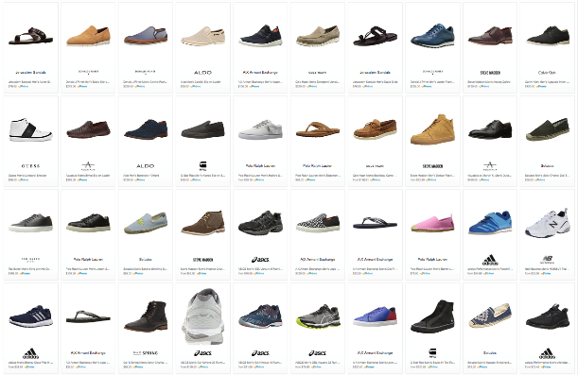

Choice Explosion
133,520 results for ”Men’s Shoes"

Slide 7



Choice Explosion
1.7 million results for ”sepatu pria"

Slide 8


Choice Explosion
4 million results results for ”男鞋/皮鞋/休闲鞋"

Slide 9
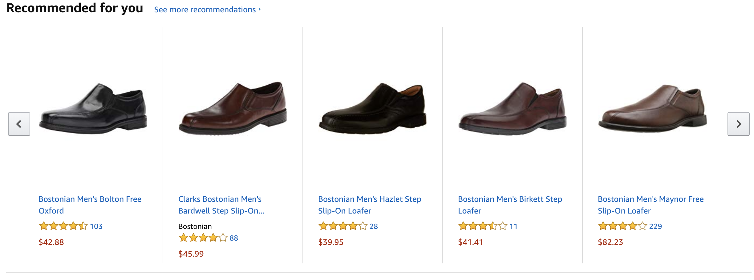
Solution: Recommender Systems

Slide 10












Applicable Across Domains

Slide 11
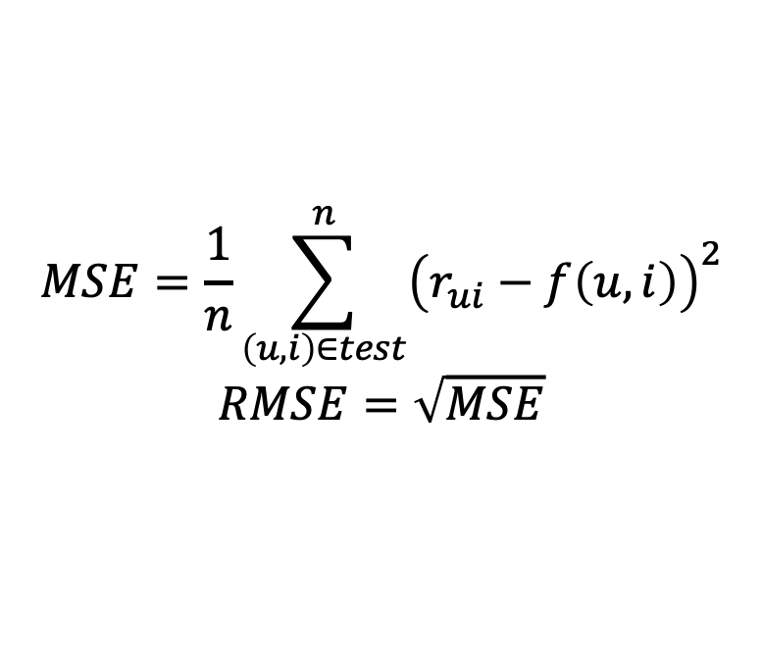
Netflix Prize Competition (2006)
Training set
~100 million ratings
~480,000 anonymous customers
17,770 movies
each movie being rated on a scale of 1 to 5 stars
Qualifying set
1.4 million ratings for quiz set and 1.4 million ratings for test set
First team to improve on the RMSE performance of Netflix’s own algorithm by >=10 percent wins a $1 million prize
$$MSE=\frac{1}{n}\sum_{\left(u,i\right)∈test}^{n}{{\left(r_{ui}−f\left(u, i\right)\right)}^{2}}$$
$$RMSE=\sqrt{MSE}$$

Slide 12
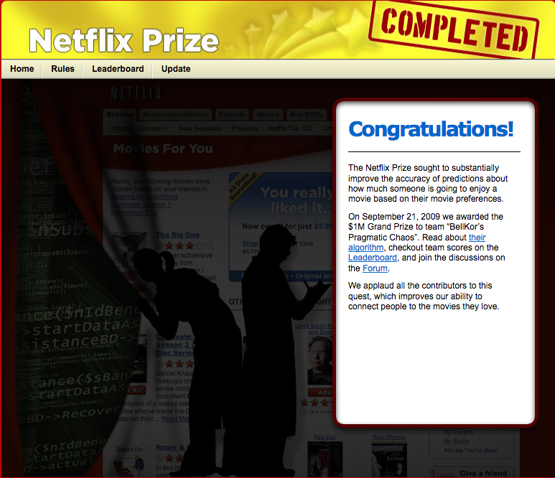
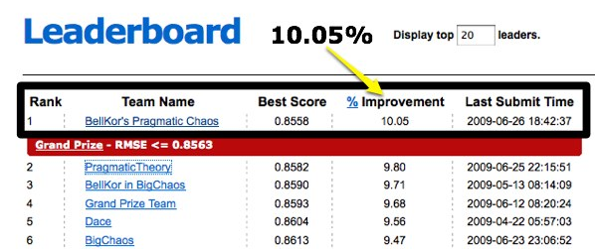
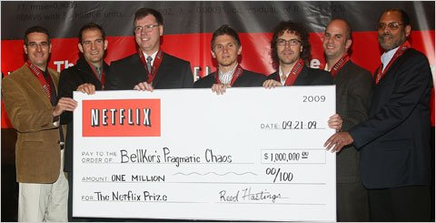
Netflix Prize
https://bits.blogs.nytimes.com/2009/09/21/netflix-awards-1-million-prize-and-starts-a-new-contest/

Slide 13
Matrix Factorization
Koren, Bell, Volinsky, "Matrix Factorization Techniques for Recommender Systems”, Computer 2009.
Our winning entries consist of more than 100 different predictor sets, the majority of which are factorization models using some variants of the methods described here. Our discussions with other top teams and postings on the public contest forum indicate that these are the most popular and successful methods for predicting ratings.
~BellKor

Slide 14
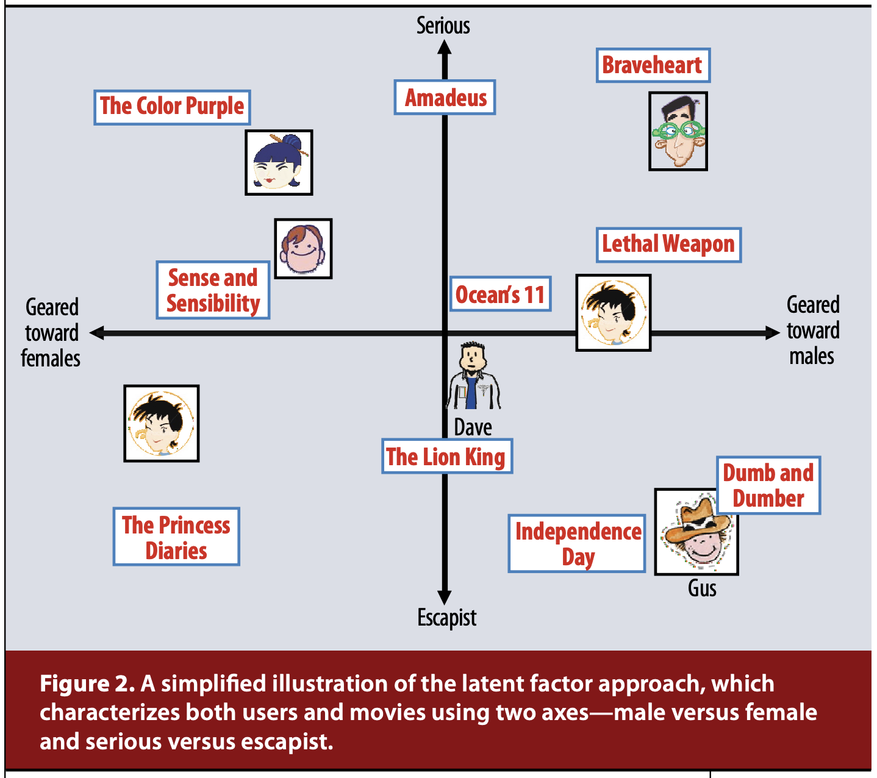
Matrix Factorization: Intuition
Koren, Bell, Volinsky, "Matrix Factorization Techniques for Recommender Systems”, Computer 2009.

Slide 15
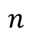
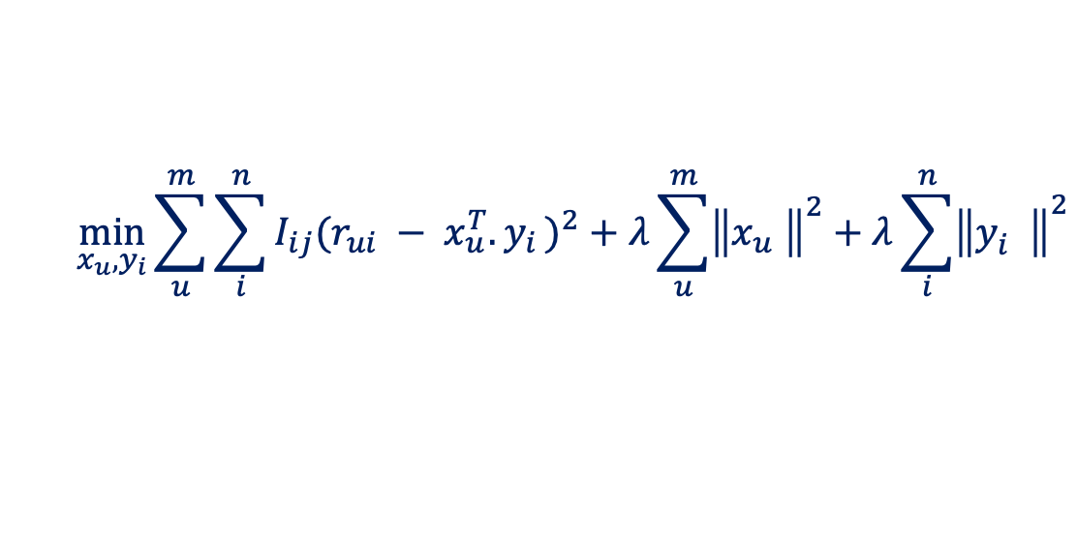

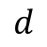

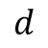


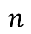
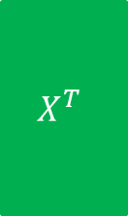
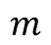
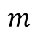

Matrix Factorization: Basics
$$n$$
$$d$$
$$n$$
$$R$$
$$X^{T}$$
$$Y$$
$$m$$
$$≈$$
$$m$$
$$×$$
$$d$$
Prediction
$${pref}_{u}\left(i\right)=x_{u}^{T}{.y}_{i}$$
$$\min_{x_{u}, y_{i}}{\sum_{u}^{m}{\sum_{i}^{n}{I_{ij}{(r_{ui} − x_{u}^{T}{.y}_{i})}^{2}}+λ\sum_{u}^{m}{{\left\|x_{u}^{}\right\|}^{2}}+λ\sum_{i}^{n}{{\left\|y_{i}^{}\right\|}^{2}}}}{}$$
Learning Objective

Slide 16




Stochastic Gradient Descent
$$n$$
$$d$$
$$n$$
$$R$$
$$X^{T}$$
$$Y$$
$$m$$
$$≈$$
$$m$$
$$×$$
$$d$$
Iterate:
$$e_{ui}=r_{ui} −x_{u}^{T}{.y}_{i}$$
$x_{u}←x_{u}+γ(e_{ui}{.y}_{i}^{}−λ$ ${.x}_{u}$)
$y_{i}←y_{i}+γ(e_{ui}{.x}_{u}^{}−λ$ ${.y}_{i}$)
where $γ i$s the learning rate

Slide 17


Explicit vs. Implicit Feedback
Explicit
Implicit
Stated clearly and readily observable
Ratings
Thumbs up/down
Suggested, though not directly expressed
Clicks, viewing time

Slide 18
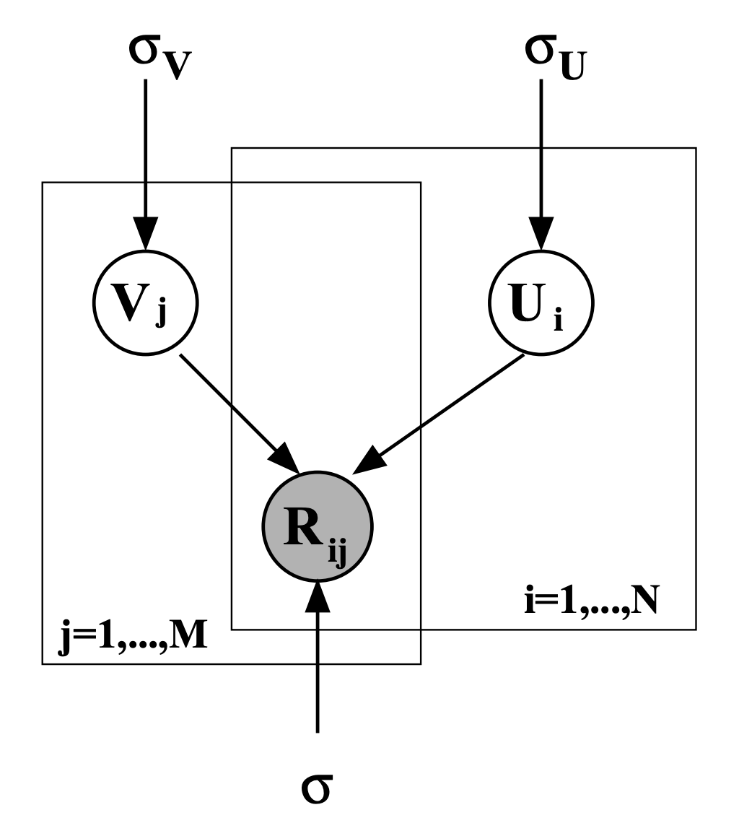
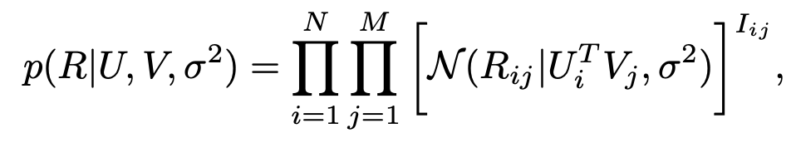
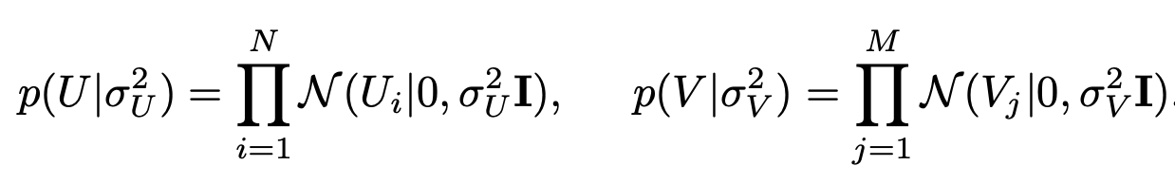
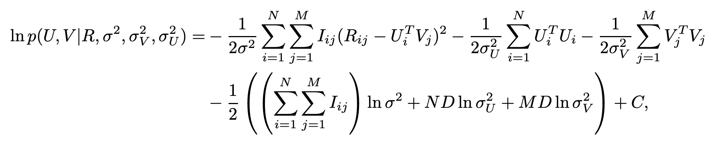
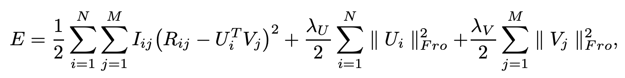
Matrix Factorization for Explicit Feedback
Salakhutdinov and Mnih, "Probabilistic Matrix Factorization", NIPS 2007

Slide 19
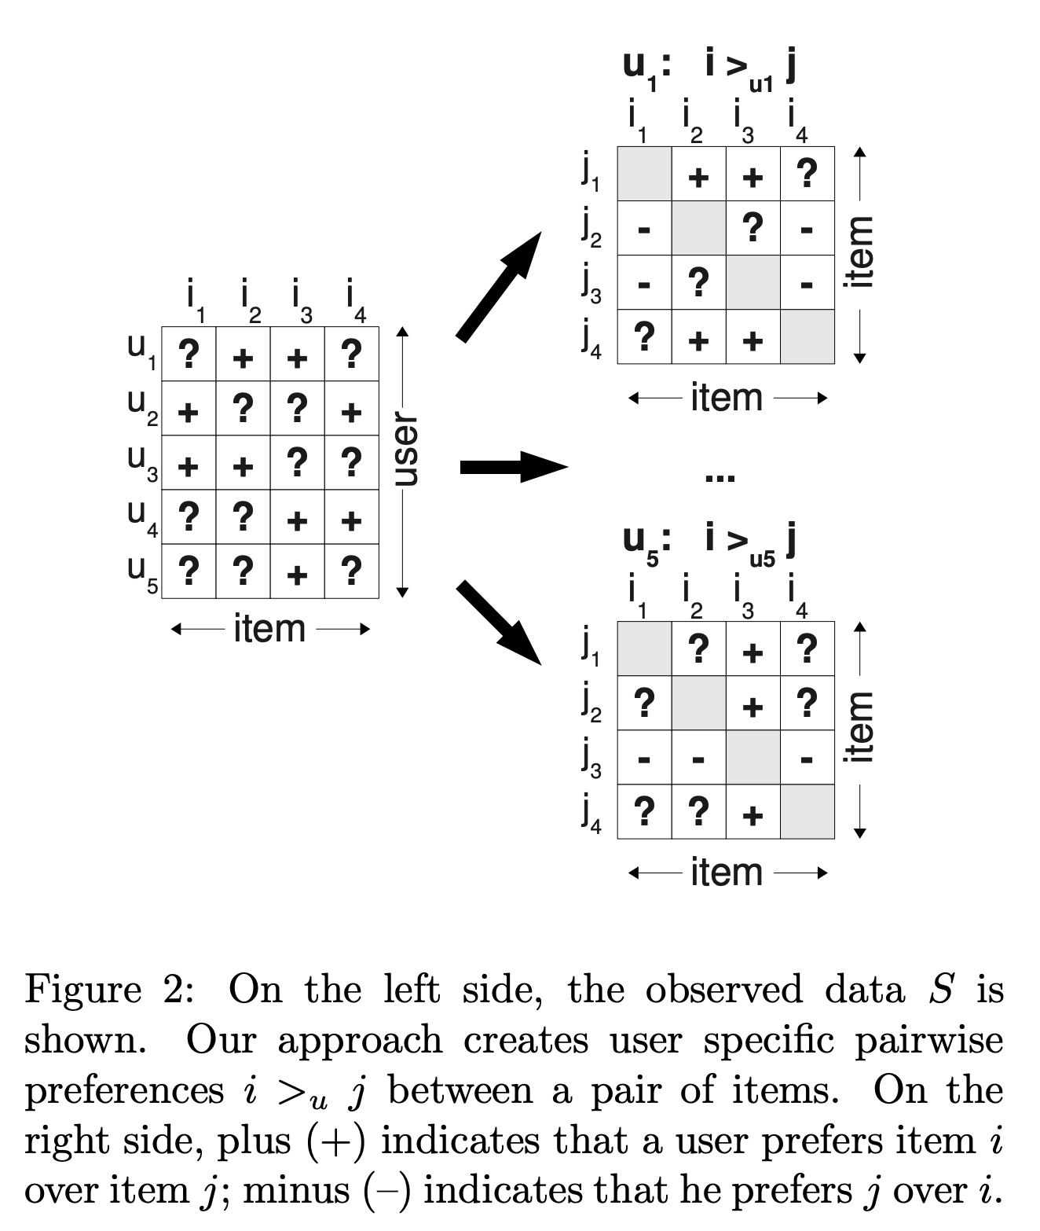
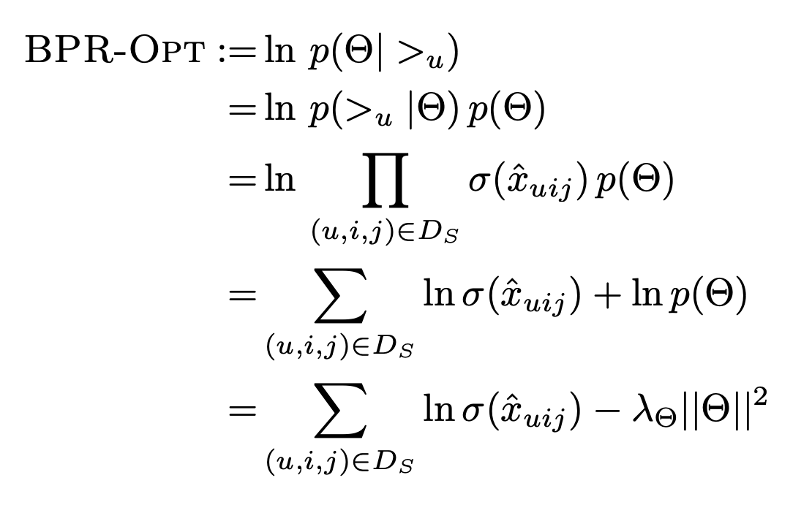
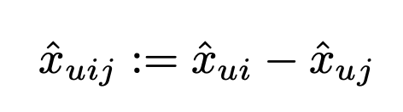
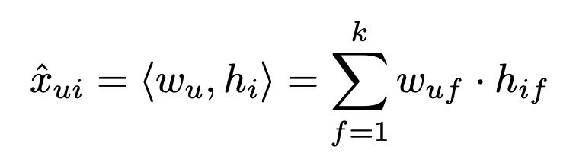
Matrix Factorization for Implicit Feedback
Salakhutdinov and Mnih, "BPR: Bayesian Personalized Ranking from Implicit Feedback", UAI 2009

Slide 20





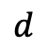
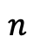


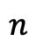


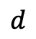


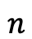
Matrix Factorization: Top-K Retrieval
$$n$$
$$pref_{u}\left(i\right)=x_{u}^{T}{.y}_{i}$$
$$d$$
$$Y$$
$$n$$
$$×$$
$$d$$
$$=$$
$$pref_{u}$$
$$1$$
$$x_{u}$$
$$1$$
$$n$$
Top-K items
$$1$$
Sorted $pref_{u}$
Maximum Inner Product Search
$$\underset{i}{argmax}{{(x}_{u}^{T}{.y}_{i})}{}$$

Slide 21




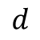
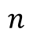
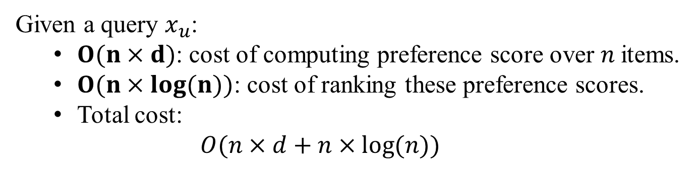


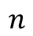


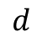


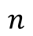
Linear Scanning
$$n$$
$$pref_{u}\left(i\right)=x_{u}^{T}{.y}_{i}$$
$$d$$
$$Y$$
$$n$$
$$×$$
$$d$$
$$=$$
$$pref_{u}$$
$$1$$
$$x_{u}$$
$$1$$
Retrieval
phase
$$n$$
Top-K items
$$1$$
Sorted $pref_{u}$
Given a query $x_{u}$:
$O(n×d)$: cost of computing preference score over $n$items.
$O(n×\log{(n)})$: cost of ranking these preference scores.
Total cost:
$O(n×d+n×\log{(n)})$

Slide 22
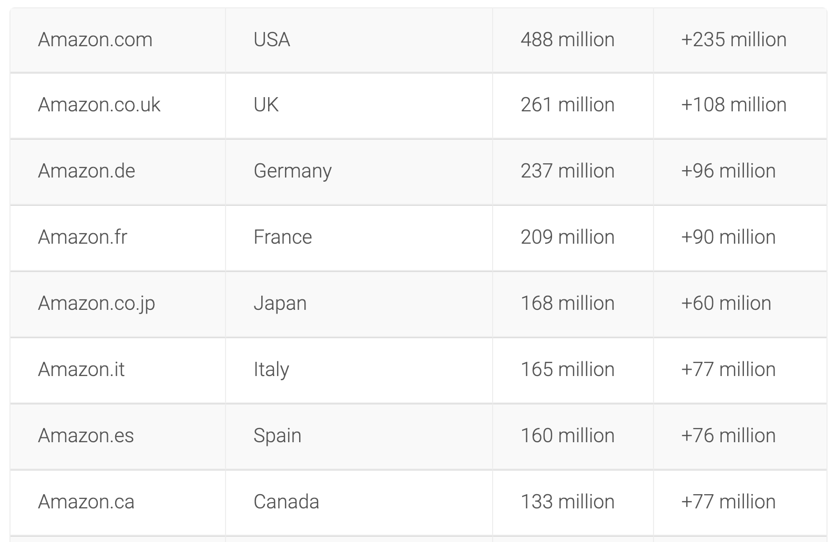
How Many Products Does Amazon Sell?
https://export-x.com/2015/12/11/how-many-products-does-amazon-sell-2015/

Slide 23
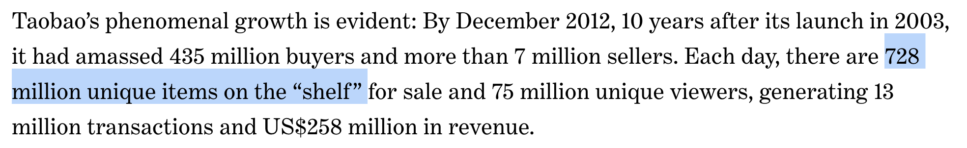
How Many Products Does Taobao Sell?
https://www.todayonline.com/chinaindia/china/growing-online-buyers-and-sellers-lessons-taobao

Slide 24
Reducing the cost of top-K
recommendation retrieval is critical !

Slide 25
How to Avoid Linear Scanning?
Linear scanning is akin to brute force
Measure similarity between user vector to every item’s vector
Lesson from database and information retrieval: indexing
Quickly narrow down the search space to a subset of items
Rank only those items in the subset
fewer inner product computations
fewer candidate items to sort
Common indexing schemes for retrieval:
Locality-sensitive hashing
Spatial index
Inverted index
While useful for general retrieval, there are issues with using these indexing schemes out of the box with recommendation retrieval

Slide 26
How to Avoid Linear Scanning?
Linear scanning is akin to brute force
Measure similarity between user vector to every item’s vector
Lesson from database and information retrieval: indexing
Quickly narrow down the search space to a subset of items
Rank only those items in the subset
fewer inner product computations
fewer candidate items to sort
Common indexing schemes for retrieval:
Locality-sensitive hashing
Spatial index
Inverted index
While useful for general retrieval, there are issues with using these indexing schemes out of the box with recommendation retrieval

Slide 27
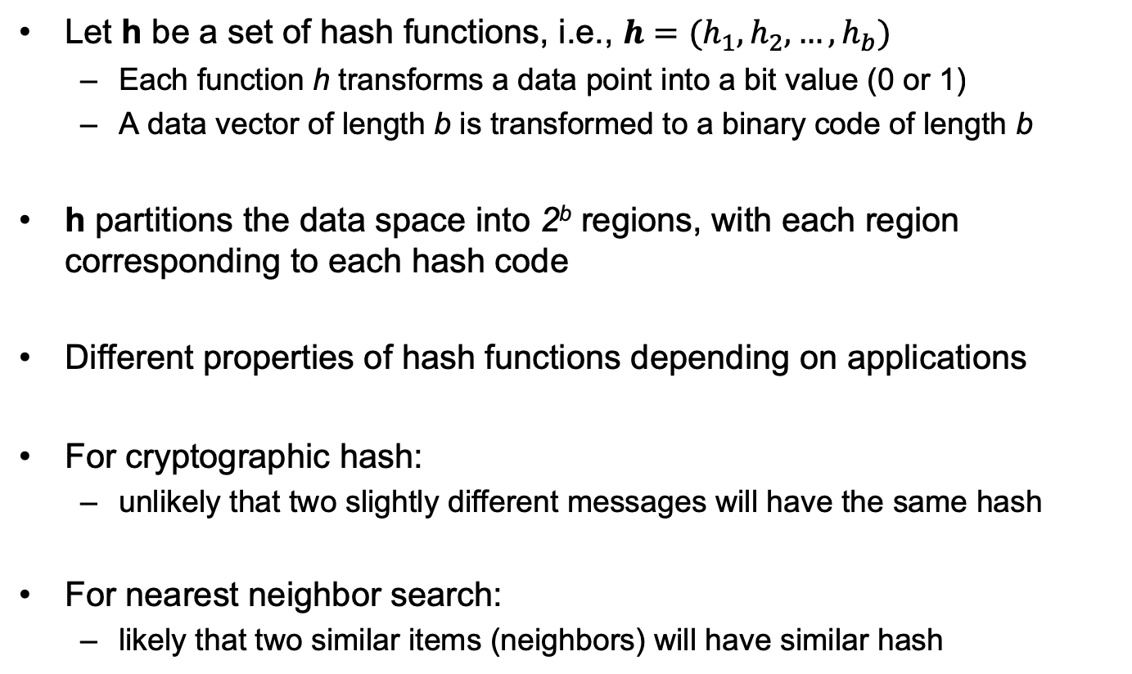
Hashing
Let h be a set of hash functions, i.e., $h=(h_{1},h_{2},…,h_{b})$
Each function h transforms a data point into a bit value (0 or 1)
A data vector of length b is transformed to a binary code of length b
h partitions the data space into 2^{b} regions, with each region corresponding to each hash code
Different properties of hash functions depending on applications
For cryptographic hash:
unlikely that two slightly different messages will have the same hash
For nearest neighbor search:
likely that two similar items (neighbors) will have similar hash

Slide 28
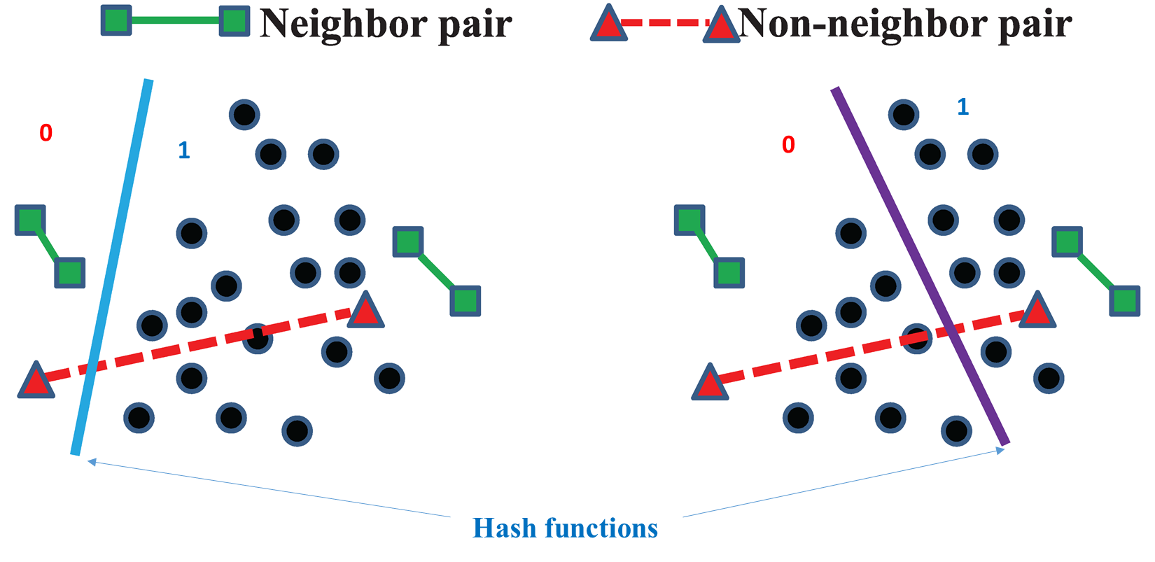
Locality-Sensitive Hashing

Slide 29
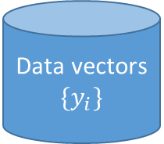
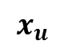
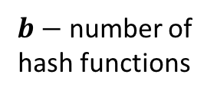
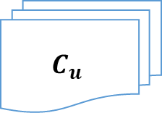
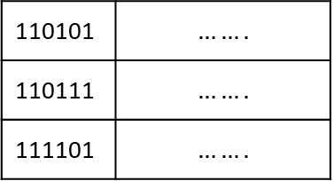
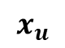
LSH for Recommendation Retrieval
Data vectors
$$\{y_{i}\}$$
$$x_{u}$$
Hash Functions
$b−$ number of hash functions
Candidate Set
$$C_{u}$$
$$x_{u}$$
110101 | $$…….$$
110111 | $$…….$$
111101 | $$…….$$
…
Top-K
Hash Table

Slide 30
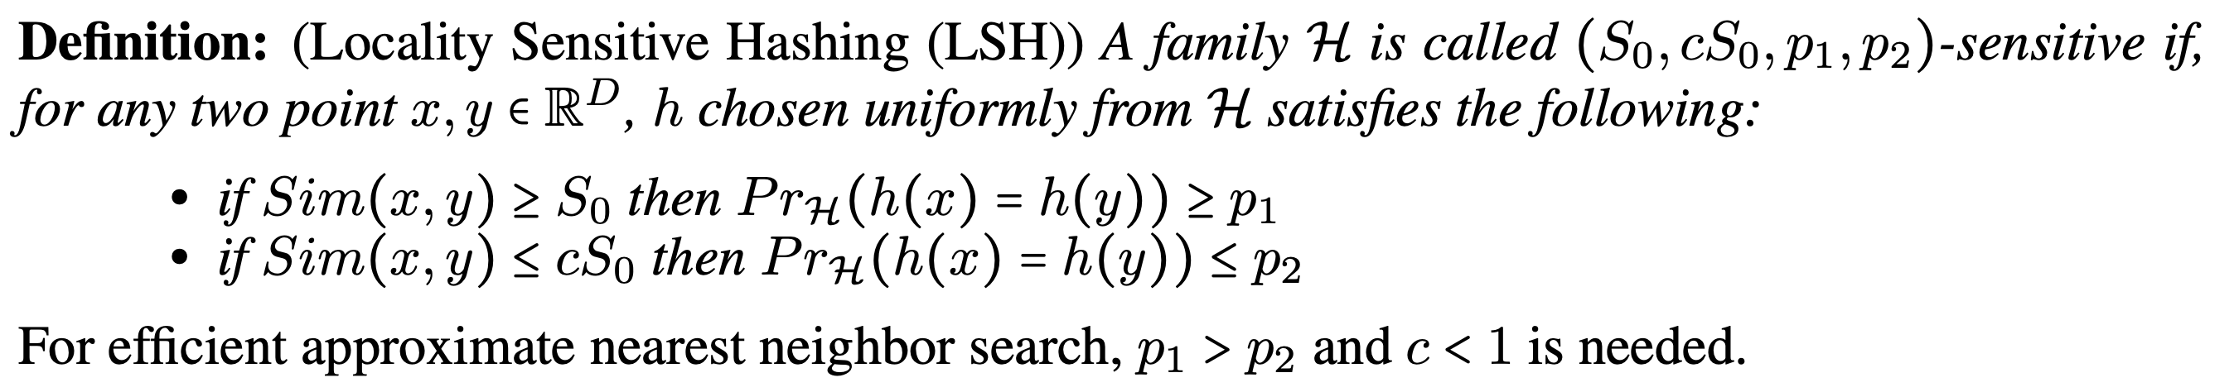
LSH Family
Shrivastava and Li, "Asymmetric LSH (ALSH) for Sublinear Time Maximum Inner Product Search (MIPS)", NIPS 2014.
If x and y are similar, the probability of having the same hash bit is high
If x and y are different, the probability of having the same hash bit is high

Slide 31

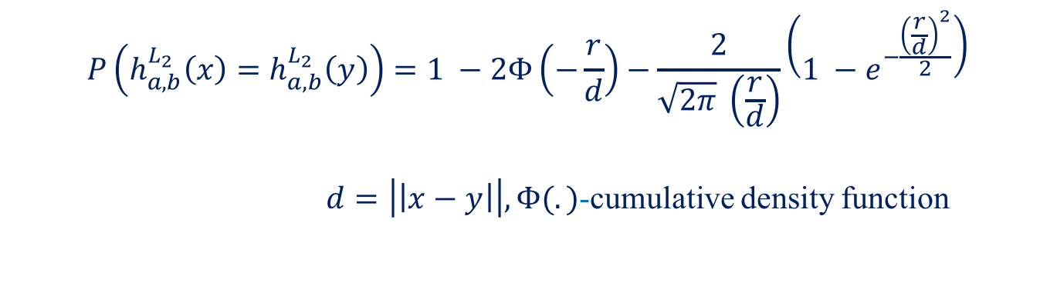
LSH for L₂ Distance
LSH for $l_{2}$ distance (given a fixed real number r):
$$h_{a,b}^{L_{2}}\left(x\right)= \left\lfloor \frac{a^{T}x+b}{r}\right\rfloor ,$$
$${a={\left\{a_{i}\right\}}_{d}, a}_{i} \sim N\left(0, 1\right), b \sim U(0, r)$$
Collision probability
$$P\left(h_{a,b}^{L_{2}}\left(x\right)=h_{a,b}^{L_{2}}\left(y\right)\right)=1 −2Φ\left(−\frac{r}{d}\right)−\frac{2}{\sqrt{2π} \left(\frac{r}{d}\right)}\left(1 −e^{−\frac{{\left(\frac{r}{d}\right)}^{2}}{2}}\right)$$
$d=\left|\left|x−y\right|\right|, Φ(.)$-cumulative density function

Slide 32
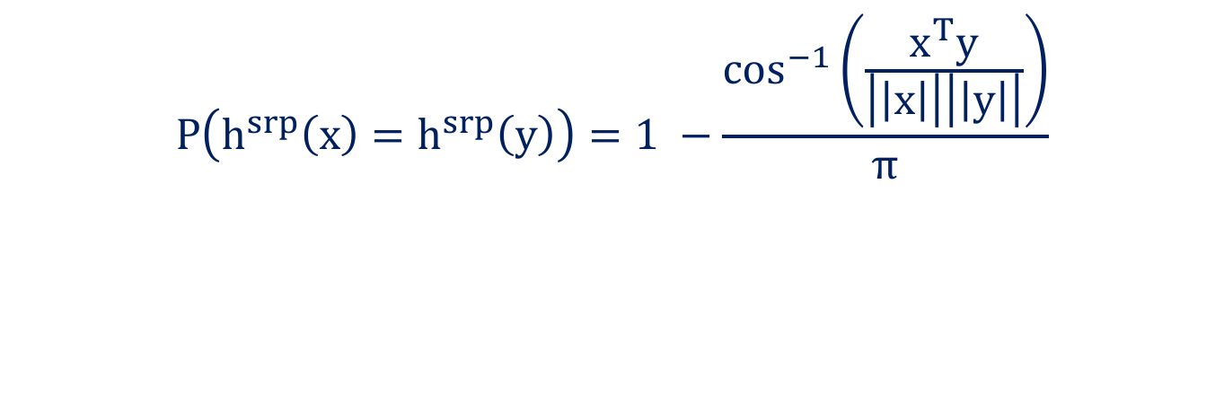

LSH for Cosine Distance
LSH for cosine distance:
$$h^{srp}\left(x\right)=sign(a^{T}x) ,$$
$${a={\left\{a_{i}\right\}}_{d}, a}_{i} \sim N\left(0, 1\right)$$
Collision probability
$$P\left(h^{srp}\left(x\right)=h^{srp}\left(y\right)\right)=1 −\frac{\cos^{−1}\left(\frac{x^{T}y}{\left|\left|x\right|\right|\left|\left|y\right|\right|}\right)}{π}$$

Slide 33
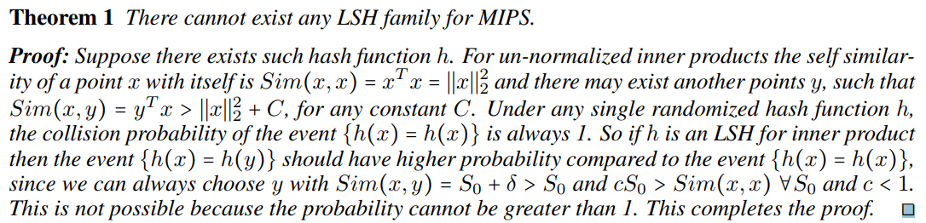
LSH for Max Inner Product Search (MIPS)?
Shrivastava and Li, "Asymmetric LSH (ALSH) for Sublinear Time Maximum Inner Product Search (MIPS)", NIPS 2014.

Slide 34
How to Avoid Linear Scanning?
Linear scanning is akin to brute force
Measure similarity between user vector to every item’s vector
Lesson from database and information retrieval: indexing
Quickly narrow down the search space to a subset of items
Rank only those items in the subset
fewer inner product computations
fewer candidate items to sort
Common indexing schemes for retrieval:
Locality-sensitive hashing
Spatial index
Inverted index
While useful for general retrieval, there are issues with using these indexing schemes out of the box with recommendation retrieval

Slide 35
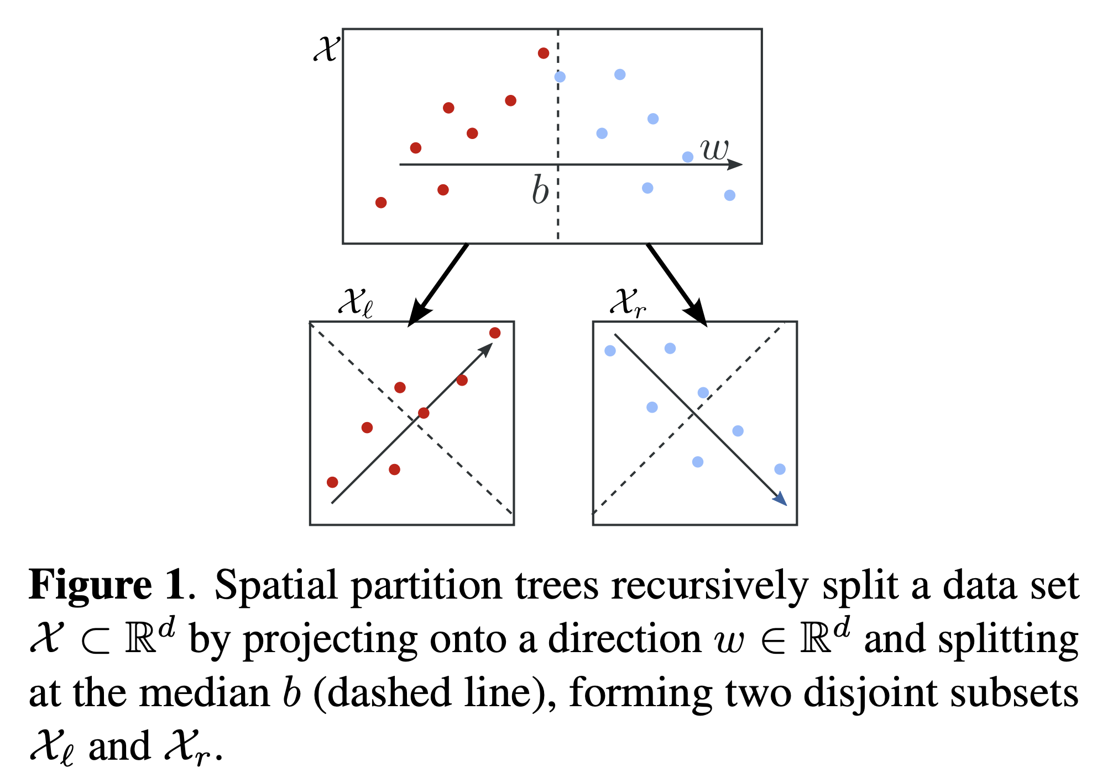
Spatial Index (Space Partitioning)
McFee and Lanckriet, "Large-scale music similarity search with spatial trees", ISMIR 2011.

Slide 36

Spatial Tree Retrieval
Phase 1: Navigate binary search tree to the appropriate leaf node
Phase 2: Inner product computations with the subset of points in leaf
Trade-off between the two phases controlled by the tree height
https://courses.cs.washington.edu/courses/cse547/17sp/slides/lsh-randproj.pdf

Slide 37

Spatial Tree Construction
McFee and Lanckriet, "Large-scale music similarity search with spatial trees", ISMIR 2011.

Slide 38

KD-Tree
Verma, Kpotufe, and Dasgupta, "Which Spatial Partition Trees are Adaptive to Intrinsic Dimension?", UAI 2009
Cycle through standard basis vectors $e_{i} \left(i∈\left\{1, 2, …, d\right\}\right)$
At level j, the split direction is $w=e_{i+1}$ with $i=j mod d$
E.g., with 3 dimensions, first split on axis x, second split on axis y, third split on axis z, fourth split on axis x, and so on
Fine for low dimensions, but perform poorly in high dimensions
Complexity of construction is $O(dn)$

Slide 39


Maximum Variance KD-Tree
Verma, Kpotufe, and Dasgupta, "Which Spatial Partition Trees are Adaptive to Intrinsic Dimension?", UAI 2009
“Cycling” through axes may not produce a good splitting direction
Choose $w=e_{i+1}$ that maximally spreads the data
$μ$ is sample mean
Complexity of construction is $O(dn)$

Slide 40


PCA-Tree
Sproull, "Refinements to nearest-neighbor searching ink-dimensional trees", Algorithmica 1991.
KD-tree is limited to splits along axis-parallel directions
PCA-tree generalizes this to any direction that maximizes the variance
Split along the leading eigenvector of the sample covariance matrix
Complexity is $O\left(dn2\right)$
There are yet other splitting rules

Slide 41



MIPS is not Nearest Neighbor Search
Spatial trees are based on Euclidean distances
Maximum Inner Product Search
$$\underset{i}{argmax}{{(x}_{u}^{T}{.y}_{i})}{}$$
Nearest Neighbor Search
$$\underset{i}{argmax}{{\left\|x_{u}−y_{i}\right\|}^{2}}$$

Slide 42
How to Avoid Linear Scanning?
Linear scanning is akin to brute force
Measure similarity between user vector to every item’s vector
Lesson from database and information retrieval: indexing
Quickly narrow down the search space to a subset of items
Rank only those items in the subset
fewer inner product computations
fewer candidate items to sort
Common indexing schemes for retrieval:
Locality-sensitive hashing
Spatial index
Inverted index
While useful for general retrieval, there are issues with using these indexing schemes out of the box with recommendation retrieval

Slide 43

Inverted Index
Manning, Raghavan and Schütze, "Introduction to Information Retrieval", Cambridge University Press. 2008.
Retrieval for sparse vectors
Commonly used for document retrieval
Recommendation vectors are dense vectors

Slide 44


Ranking via Cosine Similarity
Manning, Raghavan and Schütze, "Introduction to Information Retrieval", Cambridge University Press. 2008.
Similarity between two vectors is indicated by their angular distance

Slide 45


MIPS is not Max Cosine Similarity Search
Inverted index is based on cosine similarity
Maximum Inner Product Search
$$\underset{i}{argmax}{{(x}_{u}^{T}{.y}_{i})}{}$$
Maximum Cosine Similarity Search
$$\underset{i}{argmax}{\frac{x_{u}^{T}{.y}_{i}}{\left\|x_{u}\right\| \left\|y_{i}\right\|}}$$

Slide 46
Part I (Summary):
MF Recommendation Retrieval as Similarity Search Problem

Slide 47
Solution: Recommender Systems

Slide 48















Two Phases of a MF Recommender System
$$n$$
$$d$$
$$n$$
$$R$$
$$X^{T}$$
$$Y$$
Learning
phase
$$m$$
$$≈$$
$$m$$
$$×$$
$$d$$
$$n$$
$$pref_{u}\left(i\right)=x_{u}^{T}{.y}_{i}$$
$$d$$
$$Y$$
$$n$$
$$×$$
$$d$$
$$=$$
$$pref_{u}$$
$$1$$
$$x_{u}$$
$$1$$
Retrieval
phase
$$n$$
Top-K items
$$1$$
Sorted $pref_{u}$

Slide 49
Choice Explosion
133,520 results for ”Men’s Shoes"

Slide 50
Scalable Recommendation Retrieval
Linear scanning may not be scalable for real-time retrieval
Indexing schemes do not work out-of-the-box for Maximum Inner Product Search (MIPS)
Strategy #1: Approximate MIPS
Learn the latent vectors from matrix factorization as usual
Apply post-hoc treatment or transformations to those vectors to enable approximation
Strategy #2: Indexable Representation
Design new matrix factorization techniques that would output natively indexable latent vectors
Compatible with LSH, spatial trees, or inverted index
Strategy #3: Discrete Representation
Learn a different representation altogether, e.g., binary codes
Inherently compatible with Hamming ranking or hashtable lookup

